Slide 1
ICS 复习

Slide 2
Important parts
Appendix A
Exclude exception
Appendix C
Exclude exception

Slide 3
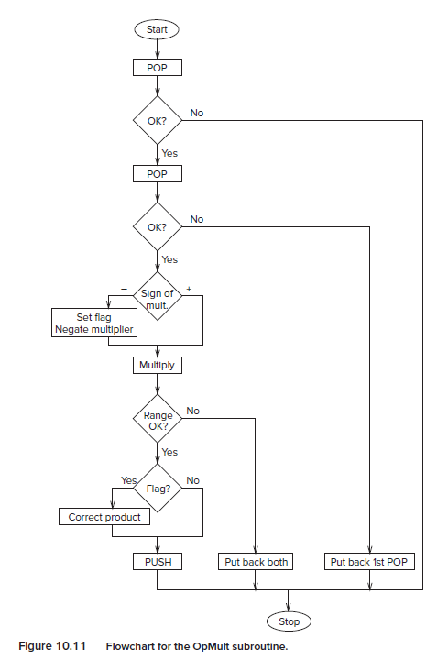
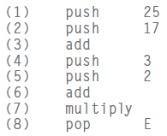
About chapter 10
Stack machines, Zero-address machine
PPT 8-2
Chapter 10.2
Simulate a calculator with LC-3
OpMult, which will pop two values from the stack, multiply them, and push the result onto the stack.

Slide 4
About chapter 10
Data Type Conversion
PPT 9-2
Chapter 10.1

Slide 5
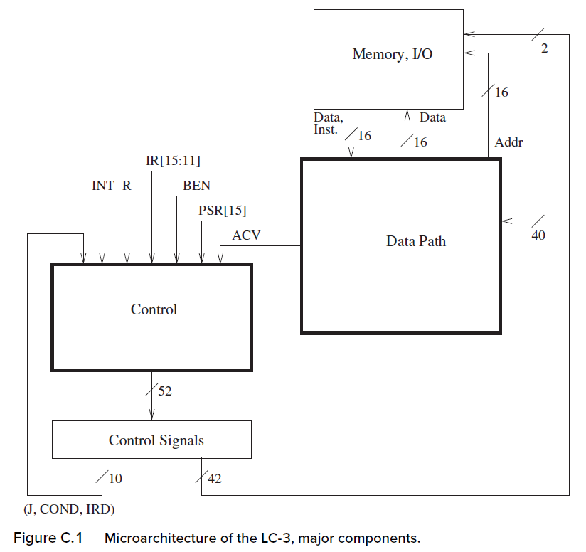
Appendix C :Microarchitecture of the LC-3
Time is divided into clock cycles.
The cycle time of a microprocessor is the duration of a clock cycle.
A common cycle time for a microprocessor today is 0.33 nanoseconds, which corresponds to 3 billion clock cycles each second. We say that such a microprocessor is operating at a frequency of 3 gigahertz, or 3 GHz.
We say, “at each instant of time,” but we really mean during each clock cycle.

Slide 6
Appendix C :Microarchitecture of the LC-3
The control signals needed in the “next” clock cycle depend on the following:
1. The control signals that are present during the current clock cycle.
2. The LC-3 instruction that is being executed.
3. The privilege mode of the program that is executing, and whether the processor has the right to access a particular memory location.
4. If that LC-3 instruction is a BR, whether the conditions for the branch have been met (i.e., the state of the relevant condition codes).
5. Whether or not an external device is requesting that the processor be interrupted.
6. If a memory operation is in progress, whether it is completing during this cycle.

Slide 7
Appendix C :Microarchitecture of the LC-3
1. J[5:0], COND[2:0], and IRD—ten bits of control signals provided by the current clock cycle.
2. IR[15:12], which identifies the opcode, and IR[11:11], which differentiates JSR from JSRR (i.e., the addressing mode for the target of the subroutine call).
3. PSR[15], bit [15] of the Processor Status Register, which indicates whether the current program is executing with supervisor or user privileges,
4. ACV, a signal that informs the processor that a process operating in User mode is trying to access a location in privileged memory. ACV stands for Access Control Violation. When asserted, it denies the process access to the privileged memory location.
5. BEN to indicate whether or not a BR should be taken.
6. INT to indicate that some external device of higher priority than the executing process requests service.
7. R to indicate the end of a memory operation.

Slide 8
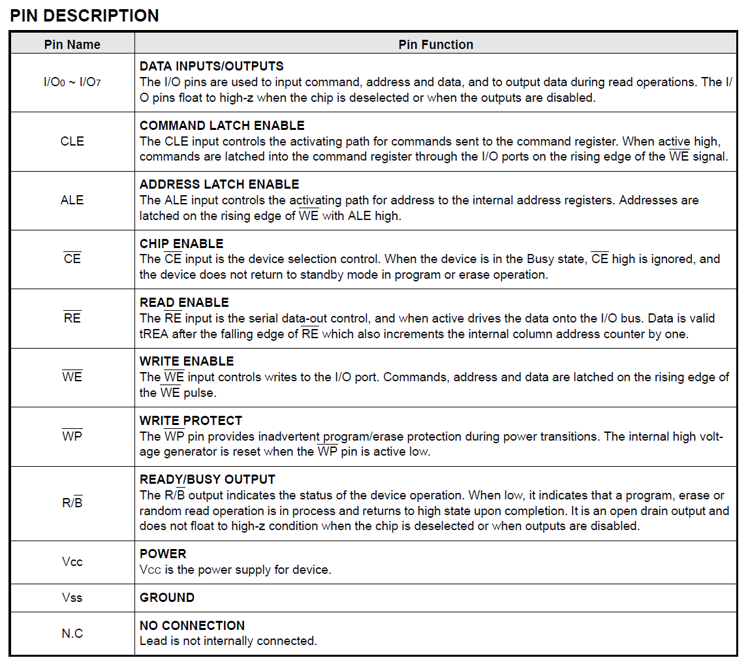
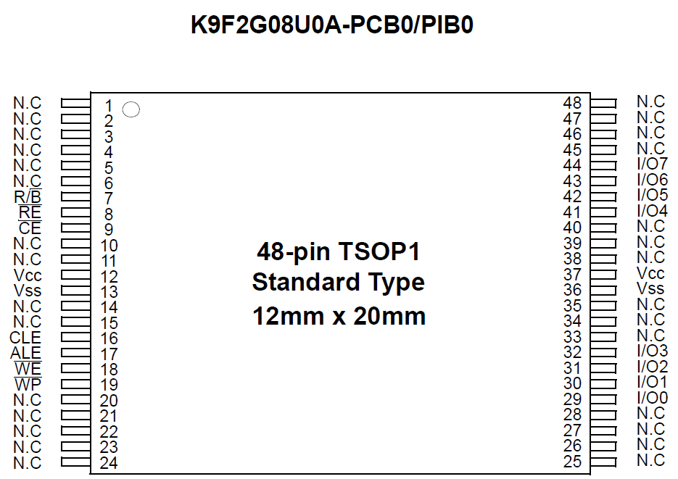
About R
A flash memory chip
READY/BUSY OUTPUT
The R/B output indicates the status of the device operation. When low, it indicates that a program, erase or
random read operation is in process and returns to high state upon completion.

Slide 9
Appendix C :Microarchitecture of the LC-3
During each clock cycle,
42 of these control signals determine the processing of information in the data path
the other 10 control signals combine with the 10 bits of additional information to determine which set of control signals will be required in the next clock cycle.
These 52 control signals specify the state of the control structure of the LC-3 microarchitecture

Slide 10
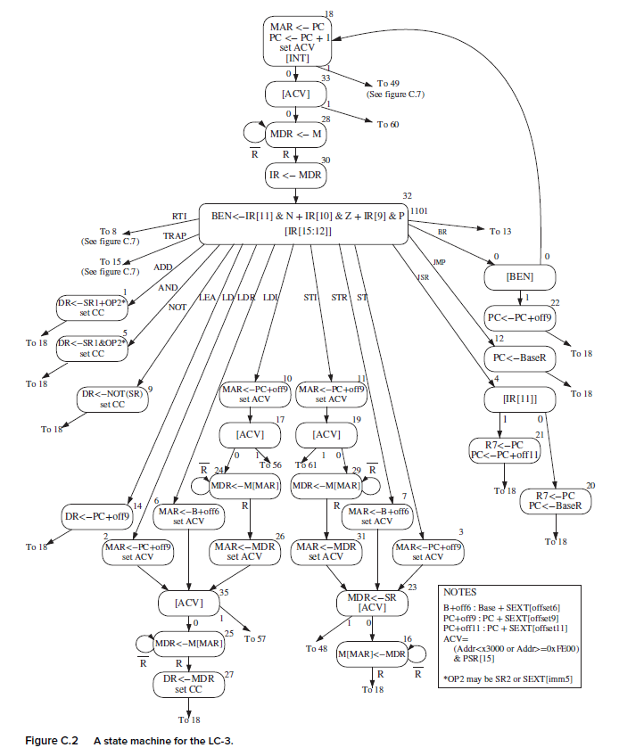
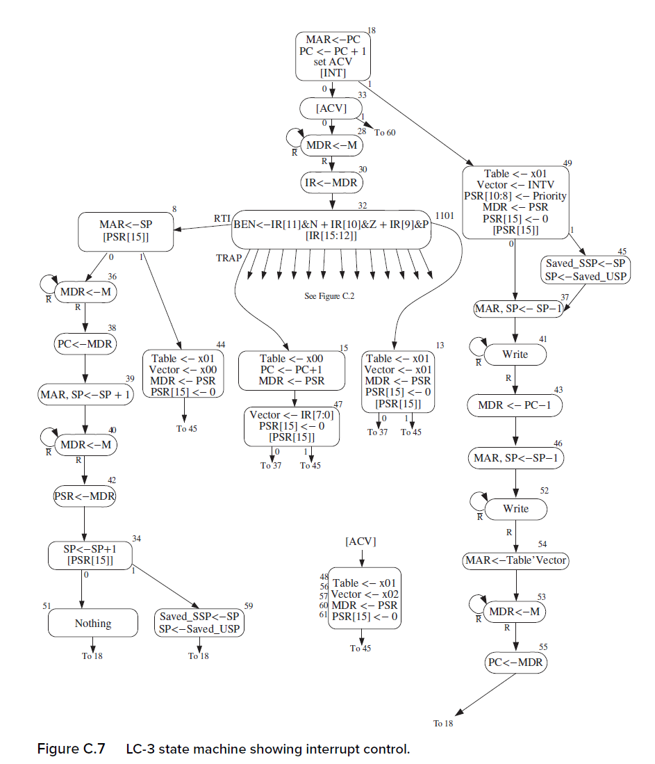
The state machine
[INT]
[ACV]
set CC
F
D
EA
OP
EX
S

Slide 11
The state machine
The state machine describes what happens during each clock cycle in which the computer is running.
Each state is active for exactly one clock cycle before control passes to the next state.
Each node in the state machine corresponds to the activity that the processor carries out during a single clock cycle.

Slide 12
The state machine
the FETCH phase of the instruction cycle
In state 18, the MAR is loaded with the address contained in PC, and the PC is incremented in reparation for the FETCH of the next LC-3 instruction after the current instruction finishes its instruction cycle.
If the content of MAR specifies privileged memory, and PSR[15] = 1, indicating User mode, the access of the instruction will not be allowed. That would be an access control violation, so ACV is set.
Finally, if there is no interrupt request present (INT = 0), the flow passes to state 33. Or else, the flow passes to state 49.

Slide 13
The state machine
the FETCH phase of the instruction cycle
From state 33, control passes to state 60 if the processor is trying to access privileged memory while in User mode, or to state 28, if the memory access is allowed, that is, if there is no ACV violation.
In state 28, since the MAR contains the address of the instruction to be processed, this instruction is read from memory and loaded into the MDR. Since this memory access can take multiple cycles, this state continues to execute until a ready signal from the memory (R) is asserted, indicating that the memory access has completed. Thus, the MDR contains the valid contents of the memory location specified by MAR.
The state machine then moves on to state 30, where the instruction is loaded into the instruction register (IR), completing the fetch phase of the instruction cycle.

Slide 14
The state machine
The state machine then moves to state 32, where DECODE takes place.
there are 16 arcs emanating from state 32, each one corresponding to bits [15:12] of the LC-3 instruction.
the arc from the last state of each instruction cycle (i.e., the state that completes the processing of that LC-3 instruction) takes us to state 18

Slide 15
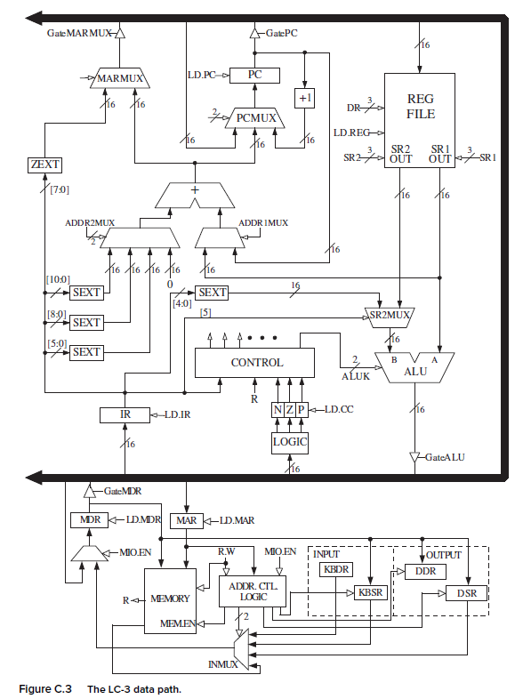
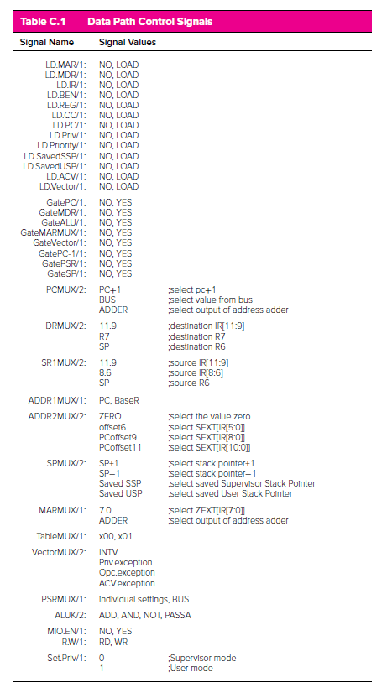
The data path
The data path consists of all components that actually process the information during each clock cycle—
the functional units that operate on the information,
the registers that store information at the end of one cycle so it will be available for further use in subsequent cycles,
and the buses and wires that carry information from one point to another in the data path.

Slide 16
The data path
LD.PC (p134)
In order for the PC to be, the finite state machine must assert the PCMUX select lines to choose the output of the box labeled +1 and must also assert the LD.PC signal to load the output of the PCMUX into the PC at the end of the current cycle.
ALUK
ALUK consists of two bits, it can have one of four values. Which value it has during any particular clock cycle depends on whether the ALU is required to ADD, AND, NOT, or simply pass one of its inputs to the output during that clock cycle (PASSA).

Slide 17
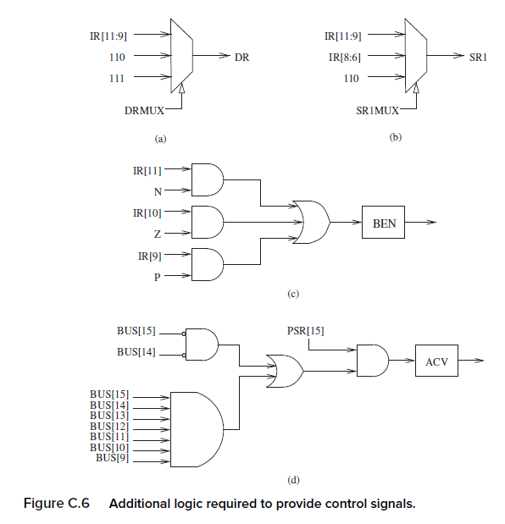
Additional logic required to provide control signals

Slide 18
Instruction Cycle (chapter 4.3 & chapter 5.6) -----including 6 phases, each phase requiring 0 or more steps.
F
Fetch instruction from memory
D
Decode instruction
EA
Evaluate address
OP
Fetch operands from memory
EX
Execute operation
S
Store result
Notes:
18

Slide 19
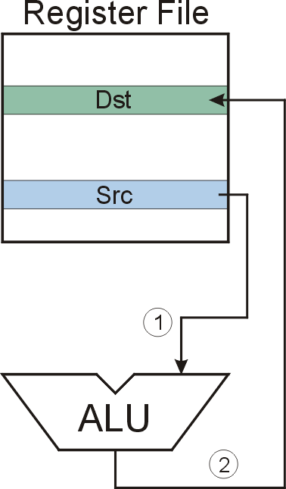
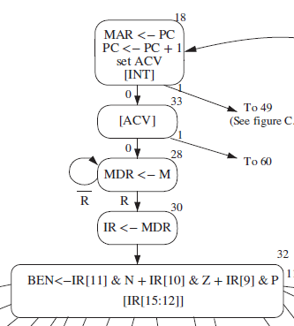

NOT (Register)
NOT
Notes:
19

Slide 20
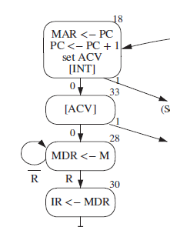
F
D
EA
NOT (Register):
OP
₁₆
GatePC
₁₆
GateMARMUX
EX
LD.PC
PC
DR
₃
MARMUX
+1
REG FILE
₁₆
₂
PCMUX
State 18
GatePC = YES
LD.MAR = LOAD
₁₆
₁₆
₁₆
₁₆
₁₆
LD.REG
S
[7:0]
SR2
SR2
OUT
SR1
OUT
SR1
SEXT
₊
₃
₃
ADDR2MUX
MUX
MUX
ADDR1MUX
₁₆
₁₆
[10:0]
₁₆
₁₆
₁₆
₁₆
₁₆
SEXT
[8:0]
LD.CC
₁₆
SEXT
FINITE STATE MACHINE
SR2MUX
[5:0]
SEXT
₁₆
N
Z
P
ALUK
_{A}
_{B}
[4:0]
SEXT
₂
ALU
LD.IR
IR
LOGIC
…
₁₆
₁₆
₁₆
RUN
GateALU
₁₆
GateMDR
₁₆
LD.MDR
MDR
MEMORY
MAR
LD.MAR
₁₆
INPUT
OUTPUT
MIO.EN
MUX
₁₆
MEM.EN,R,W

Slide 21
F
D
EA
NOT (Register):
OP
₁₆
GatePC
₁₆
GateMARMUX
EX
LD.PC
PC
DR
₃
MARMUX
+1
REG FILE
₁₆
₂
PCMUX
此处与教材不一致
State 28
LD.PC = LOAD
LD.MDR = LOAD
MIO.EN = YES
PCMUX = PC + 1
₁₆
₁₆
₁₆
₁₆
₁₆
LD.REG
S
[7:0]
SR2
SR2
OUT
SR1
OUT
SR1
SEXT
₊
₃
₃
ADDR2MUX
MUX
MUX
ADDR1MUX
₁₆
₁₆
[10:0]
₁₆
₁₆
₁₆
₁₆
₁₆
SEXT
[8:0]
LD.CC
₁₆
SEXT
FINITE STATE MACHINE
SR2MUX
[5:0]
SEXT
₁₆
N
Z
P
ALUK
_{A}
_{B}
[4:0]
SEXT
₂
ALU
LD.IR
IR
LOGIC
…
₁₆
₁₆
₁₆
RUN
GateALU
₁₆
GateMDR
₁₆
LD.MDR
MDR
MEMORY
MAR
LD.MAR
₁₆
INPUT
OUTPUT
MIO.EN
MUX
₁₆
MEM.EN,R,W

Slide 22
F
D
EA
NOT (Register):
OP
₁₆
GatePC
₁₆
GateMARMUX
EX
LD.PC
PC
DR
₃
MARMUX
+1
REG FILE
₁₆
₂
PCMUX
State 30
LD.IR = LOAD
GateMDR = YES
₁₆
₁₆
₁₆
₁₆
₁₆
LD.REG
S
[7:0]
SR2
SR2
OUT
SR1
OUT
SR1
SEXT
₊
₃
₃
ADDR2MUX
MUX
MUX
ADDR1MUX
₁₆
₁₆
[10:0]
₁₆
₁₆
₁₆
₁₆
₁₆
SEXT
[8:0]
LD.CC
₁₆
SEXT
FINITE STATE MACHINE
SR2MUX
[5:0]
SEXT
₁₆
N
Z
P
ALUK
_{A}
_{B}
[4:0]
SEXT
₂
ALU
LD.IR
LD.IR
IR
LOGIC
…
₁₆
₁₆
₁₆
RUN
GateALU
₁₆
GateMDR
₁₆
LD.MDR
MDR
MEMORY
MAR
LD.MAR
₁₆
INPUT
OUTPUT
MIO.EN
MUX
₁₆
MEM.EN,R,W

Slide 23

NOT (Register):
F
D
EA
OP
EX
S
₁₆
GatePC
₁₆
GateMARMUX
State 32
ALUK = NOT
LD.PC
PC
DR
₃
MARMUX
+1
REG FILE
₁₆
₂
PCMUX
₁₆
₁₆
₁₆
₁₆
₁₆
LD.REG
[7:0]
SR2
SR2
OUT
SR1
OUT
SR1
SEXT
₊
₃
₃
ADDR2MUX
MUX
MUX
ADDR1MUX
₁₆
₁₆
[10:0]
₁₆
₁₆
₁₆
₁₆
₁₆
SEXT
[8:0]
LD.CC
₁₆
SEXT
FINITE STATE MACHINE
SR2MUX
[5:0]
SEXT
₁₆
N
Z
P
NOT
_{A}
_{B}
[4:0]
SEXT
₂
ALU
LD.IR
IR
LOGIC
…
₁₆
₁₆
₁₆
RUN
GateALU
₁₆
GateMDR
₁₆
LD.MDR
MDR
MEMORY
MAR
LD.MAR
₁₆
INPUT
OUTPUT
MIO.EN
MUX
₁₆
MEM.EN,R,W

Slide 24

NOT (Register):
F
D
EA
OP
EX
S
参考p131-132
₁₆
GatePC
₁₆
GateMARMUX
State machine省略了OP and S phases
LD.PC
PC
DR
₃
REG FILE
MARMUX
₂
PCMUX
+1
State 9
SR1MUX =IR[8:6]
ALUK = NOT
LD.REG=LOAD
GateALU = YES
DRMUX = IR[11:9]
LD.CC = LOAD
₁₆
LD.REG
₁₆
₁₆
₁₆
₁₆
₁₆
[7:0]
SR2
SR2
OUT
SR1
OUT
SR1
SEXT
₊
₃
₃
ADDR2MUX
MUX
MUX
ADDR1MUX
₁₆
₁₆
[10:0]
₁₆
₁₆
₁₆
₁₆
₁₆
SEXT
[8:0]
LD.CC
₁₆
SEXT
FINITE STATE MACHINE
SR2MUX
[5:0]
SEXT
₁₆
N
Z
P
NOT
_{A}
_{B}
[4:0]
SEXT
₂
ALU
LD.IR
IR
LOGIC
…
₁₆
₁₆
₁₆
RUN
GateALU
₁₆
GateMDR
₁₆
LD.MDR
MDR
MEMORY
MAR
LD.MAR
₁₆
INPUT
OUTPUT
MIO.EN
MUX
₁₆
MEM.EN,R,W

Slide 25
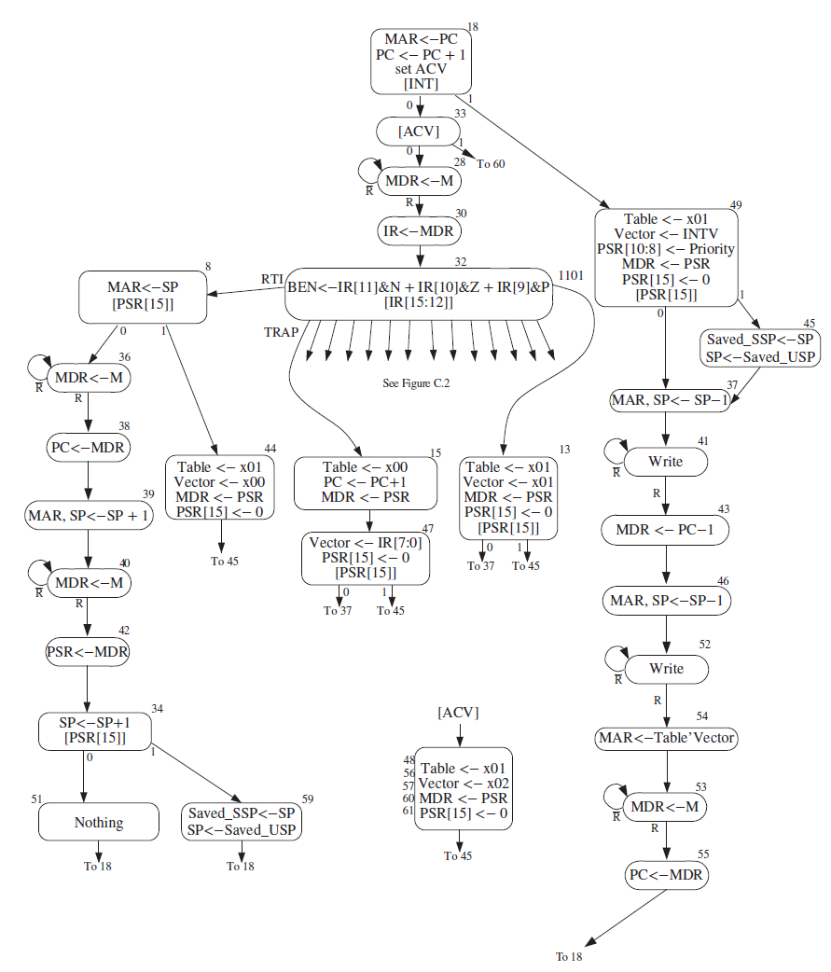
Interrupt and RTI
Interrupt
State 18 is the only state in which the processor checks for interrupts
State 45, switch stack
State 41, write PSR
State 52, write PC
State 53, read new instruction
Table‘Vector: concatenating Table and Vector
Table : 0x00, trap
0x01, interrupt

Slide 26
TRAP and RTI
RTI
State 8, exception detection
State 8, 36, 38, restore PC
State 39, 40, 42, restore PSR
State 59, switch stack

